Slide 1
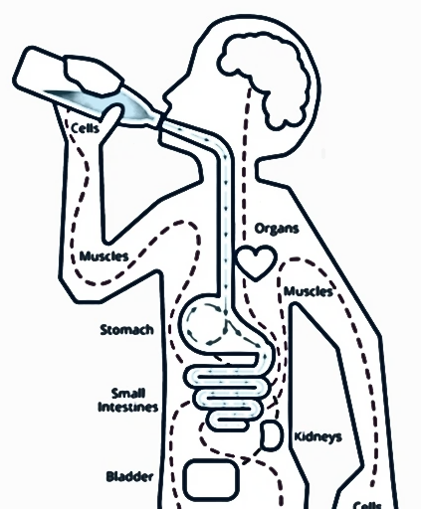
Absorption of
Ions, Water, Glucose and
The Absorptive States
Digestion and Renal Science (DRS) – Lecture 6
Dr Songyang Li
s.li.15@bham.ac.uk

Slide 2
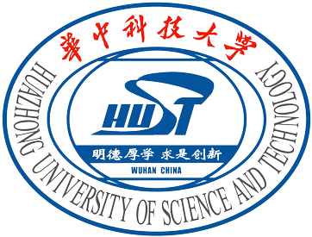


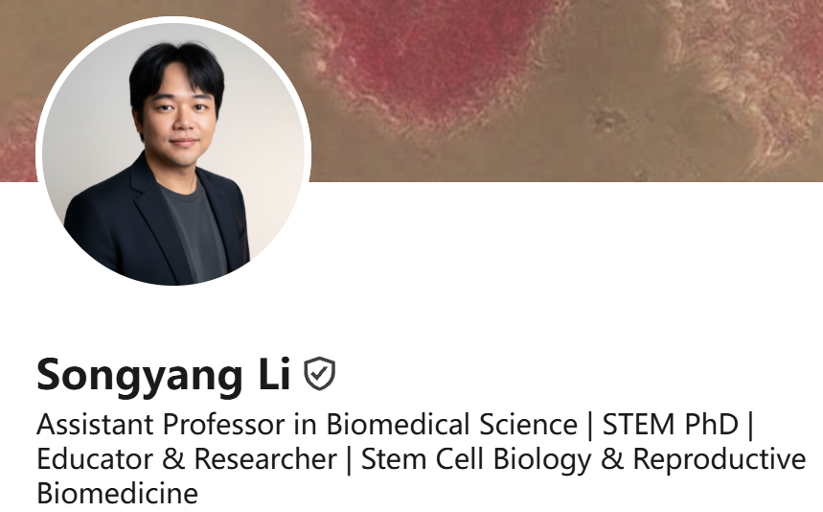
YOUR EXPERIENCE MATTERS
Student Belonging & Experience | 学生归属感与学习体验
• We want to understand what it feels like to study in the UoB–HUST JEP.
• Belonging to HUST, Birmingham and the JEP
• Friends, teaching, learning in English — and being heard
• This projected is being funded by
University of Birmingham’s Education in Practise funding 26-27.
https://bham.sharepoint.com/sites/aseddev/SitePages/EPF-Projects-2026-27.aspx

Slide 3

WHAT ARE WE DOING?
Activities shaped by students | 让学生参与改善体验
• Peer support and PASS / 同伴互助
• Student Voice Forum / 学生意见交流
• Social and community activities / 社交活动 i.e. sports, music, social events, summer school
• Your feedback helps us understand what works and what needs improving.

Slide 4
HOW CAN YOU TAKE PART?
Share your experience | 分享你的真实感受
• Complete the short student experience survey — English or Chinese is welcome.
• Taking part is voluntary; your grades and support will not be affected.
• Responses are treated confidentially; findings may be used in academic publications. 数据可能会被适用于中国国家社会科学基金/国社科
• Optional prize draw: a chance to win a ¥100 voucher.
• Survey QR code: https://forms.cloud.microsoft/e/uDhdvRv5zf

Slide 5
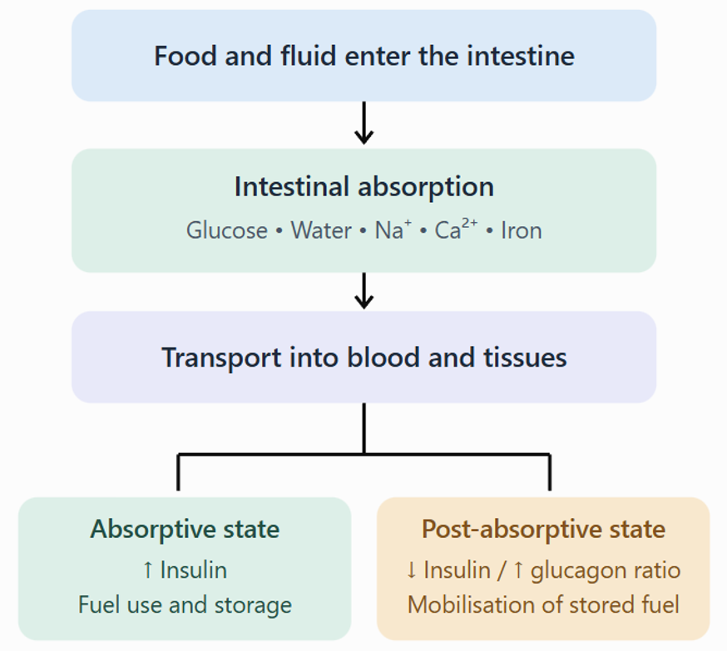
Absorption of ions, water and glucose
water follows solute, especially NaCl and absorbed nutrients
glucose absorption links epithelial transport to postprandial metabolism
calcium and iron show why some nutrients require hormonal regulation
absorptive and post-absorptive states connect gut absorption to whole-body fuel use
diarrhoea, bone disease, anaemia and diabetes can be explained from transport physiology

Slide 6
Lecture-specific outcomes
describe intestinal water absorption and explain why water follows solute
compare Na⁺, glucose, Ca²⁺ and Fe absorption routes
explain how SGLT1, GLUT2 and Na⁺/K⁺ ATPase support glucose uptake
describe enterotoxin effects on ion transport and dehydration risk
explain calcium deficiency, hepcidin regulation and anaemia mechanisms
distinguish absorptive and post-absorptive states and relate diabetes to normal physiology

Slide 7
Starter case: the same intestine, three outcomes
Pause, think, how does each case happen?
After a carbohydrate meal, plasma glucose rises.
During diarrhoea, water is lost in stool.
During chronic inflammation, iron may be stored but unavailable.

Slide 8
Digestion and Renal Sciences
Part 1
Absorption as epithelial transport
From lumen to blood: direction, route and driving force

Slide 9
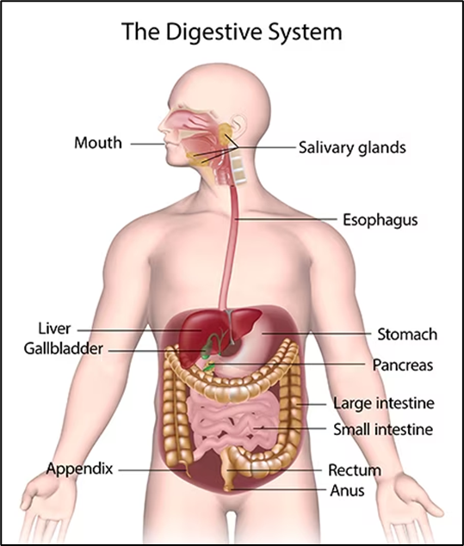
Digestion makes absorbable units; absorption moves them
digestion: chemical and mechanical processing of food into absorbable forms
absorption: movement across intestinal epithelium into blood or lymph
Postprandial/absoprtive state: nutrient-rich period after a meal
small intestine: major site for nutrient, ion and water absorption
colon: important for water and electrolyte salvage

Slide 10
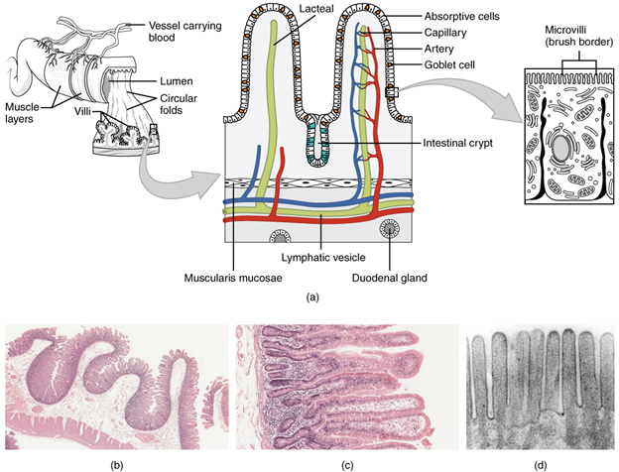
The absorptive surface is large, but selective
folds, villi and microvilli increase absorptive surface area
a single epithelial layer separates lumen from internal environment
tight junctions regulate paracellular permeability
capillaries receive most absorbed water-soluble solutes
lacteals receive many absorbed lipids through lymphatic transport

Slide 11
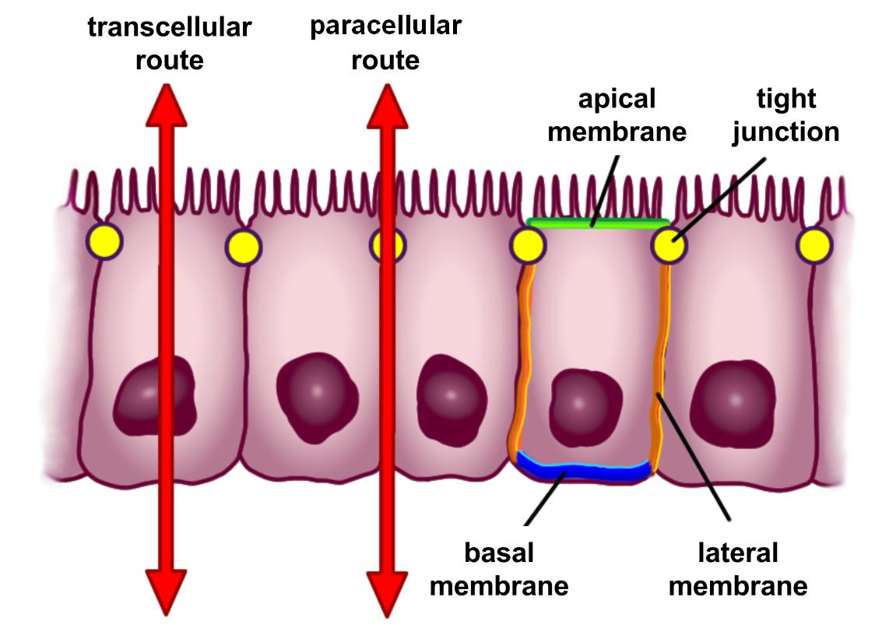
Two epithelial movement routes: transcellular and paracellular
Transcellular route
Paracellular route
crosses apical membrane
moves through enterocyte
crosses basolateral membrane
requires channels, carriers or pumps
can be active, secondary active or facilitated
moves between epithelial cells
passes through tight-junction region
usually passive
depends on electrochemical/osmotic gradients
important for water and some ions

Slide 12
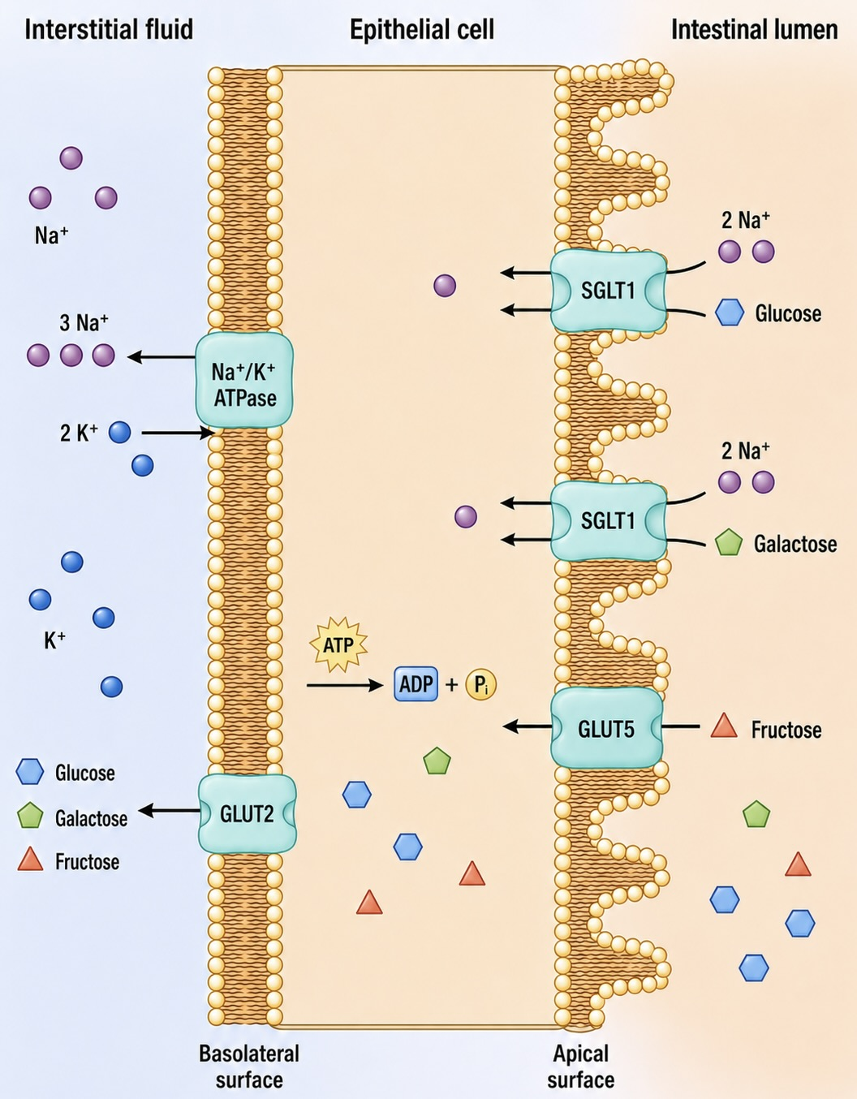
Apical and basolateral membranes do different jobs
apical membrane faces the intestinal lumen
basolateral membrane faces interstitial fluid, capillaries and lymphatics
transporters are deliberately placed on one side or the other
the same protein family name does not mean the same location or role
directional absorption depends on this polarity
10

Slide 13
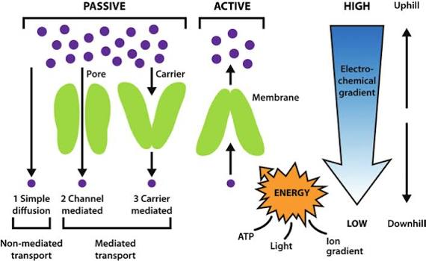
What actually drives absorption?
Passive or downhill
Active or coupled
concentration gradient
electrical gradient
osmotic gradient for water
facilitated diffusion through channels/carriers
paracellular movement through junctions
primary active transport uses ATP directly
secondary active transport uses stored ion gradients
Na⁺ gradient powers nutrient cotransport
binding proteins lower free intracellular concentration
hormones regulate transporter expression

Slide 14
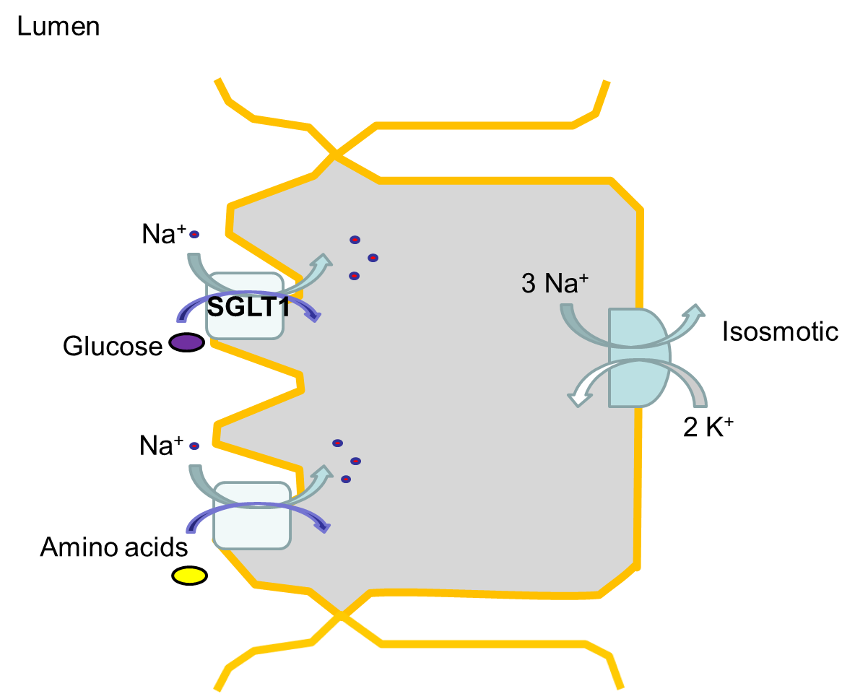
The Na⁺/K⁺ ATPase is the hidden engine
ATP used at basolateral membrane
3 Na⁺ out / 2 K⁺ in
intracellular Na⁺ stays low
Na⁺ enters from lumen
glucose, amino acids and NaCl absorption are supported
apical membrane
basolateral membrane

Slide 15
Digestion and Renal Sciences
Part 2
Water and NaCl absorption
Water follows solute, but the epithelial details matter

Slide 16
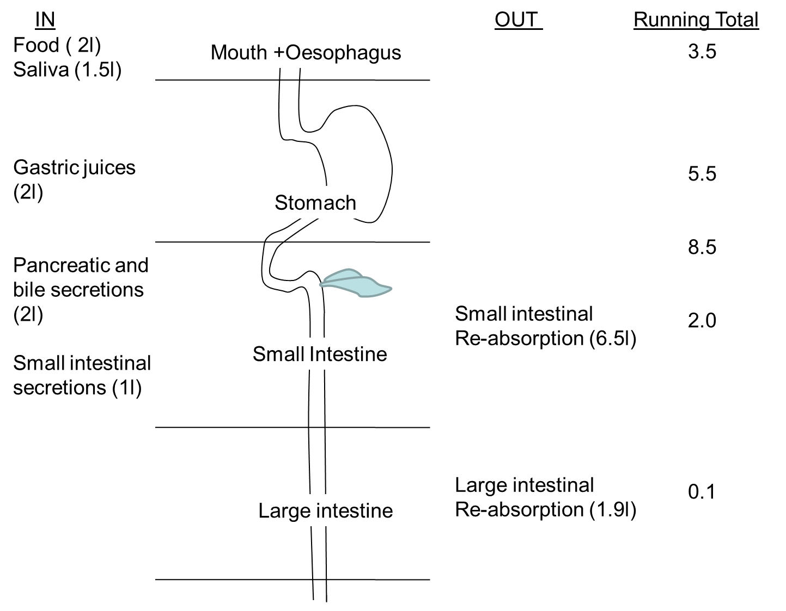
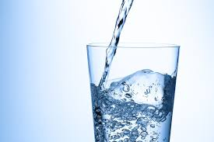
Daily fluid load is larger than what we drink
oral intake is only part of luminal fluid load
saliva, gastric juice, pancreatic secretions and bile add fluid
small intestine absorbs most of this fluid
colon salvages remaining
Too much / too little
  Constipation
  Diarrhoea

Slide 17
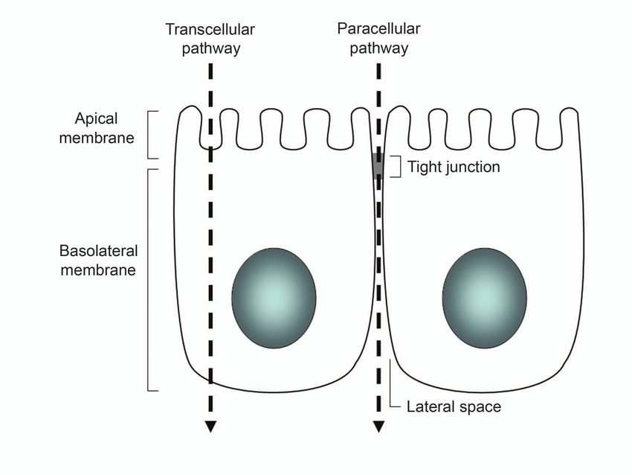
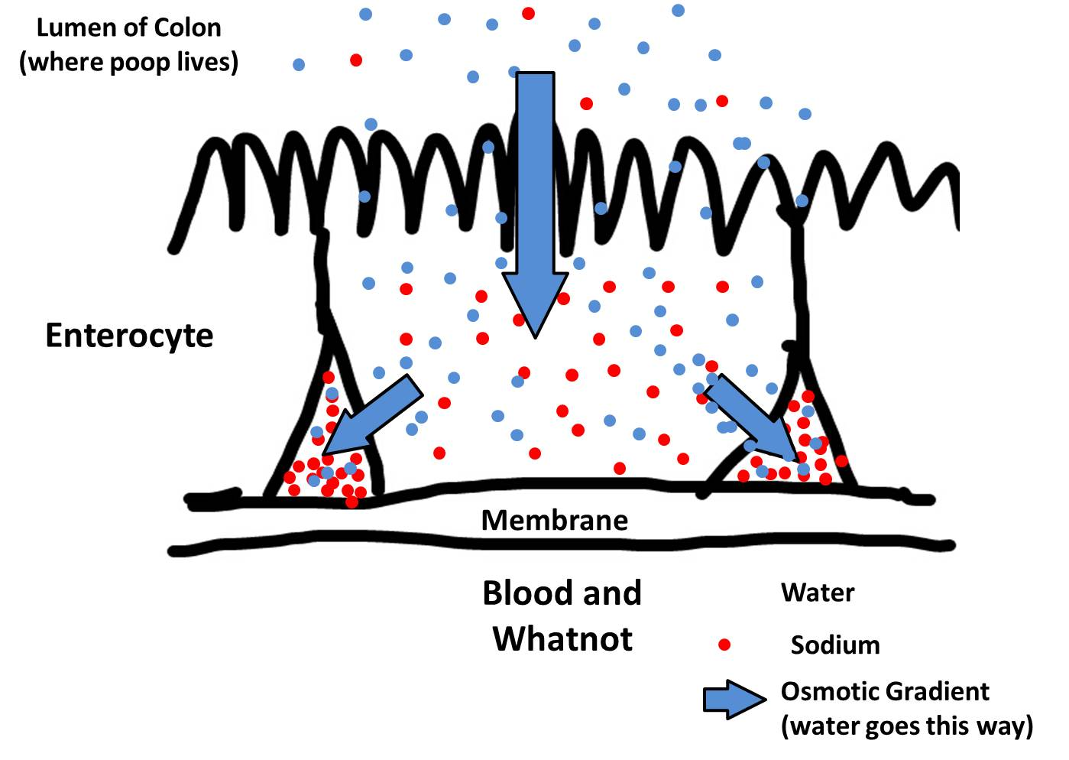
Water absorption depends mainly on osmotic gradients
Na⁺ and Cl⁻ move from lumen toward intercellular / blood side
local osmotic gradient forms near lateral spaces
water follows through paracellular and transcellular routes
tight junction properties influence water permeability
glucose-coupled Na⁺ uptake strongly supports water absorption

Slide 18
Where is sodium absorbed?
Na⁺ is absorbed along much of the intestine
Apical route:
Na⁺ / glucose (SGLT1) or Na⁺ / AA:
Na⁺ with glucose/galactose, especially after meals
Na⁺ / amino-acid cotransport after protein digestion
2. Na⁺ / H⁺ exchange absorbs sodium without glucose
3. parallel Na⁺/H⁺ and Cl⁻/HCO₃⁻ exchange absorbs NaCl between meals
Basal route:
Na+/K+ ATPase
Creates the gradient (basal side)
Keeps intracellular Na+ low

Slide 19
Route 1: Na⁺–glucose/AA cotransport
Na⁺/K⁺ ATPase keeps Na⁺ low
SGLT1 binds Na⁺ + glucose
Na⁺ moves down gradient
glucose enters enterocyte
water follows osmotically
The same transporter helps absorb glucose and water.

Slide 20
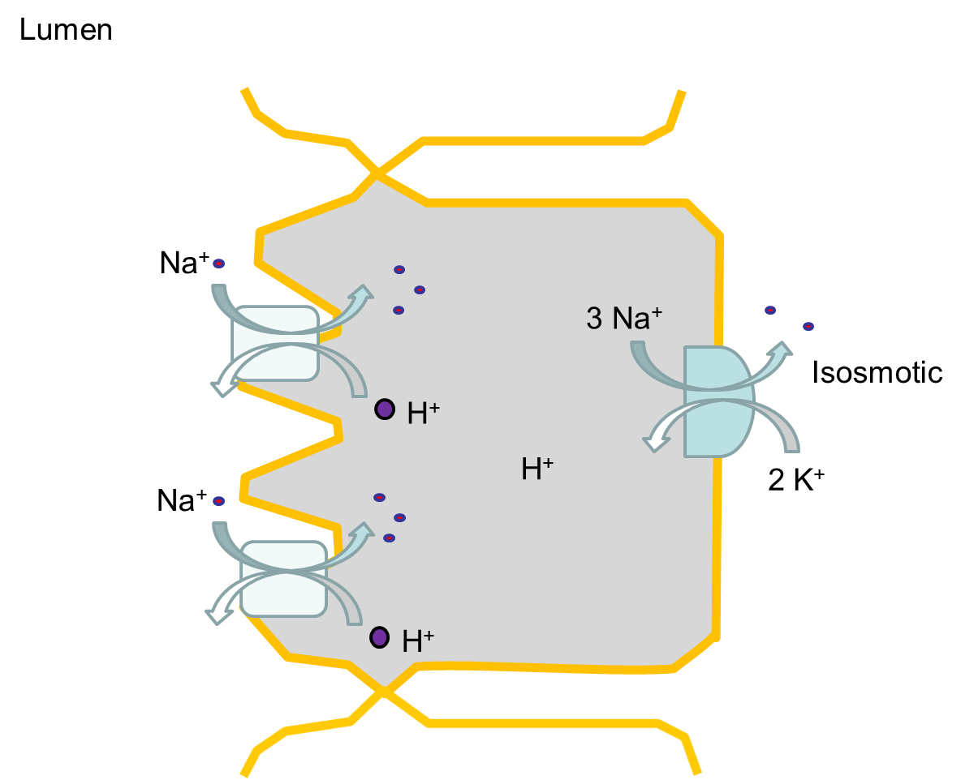
Route 2: Na⁺ / H⁺ exchange
apical Na⁺/H⁺ exchanger brings Na⁺ into enterocyte
H⁺ (proton) is secreted into the lumen
Na⁺ electrochemical gradient
important in small intestine and colon
When pH is neutral or alkaline (Secretion HCO3-)
NHE3

Slide 21
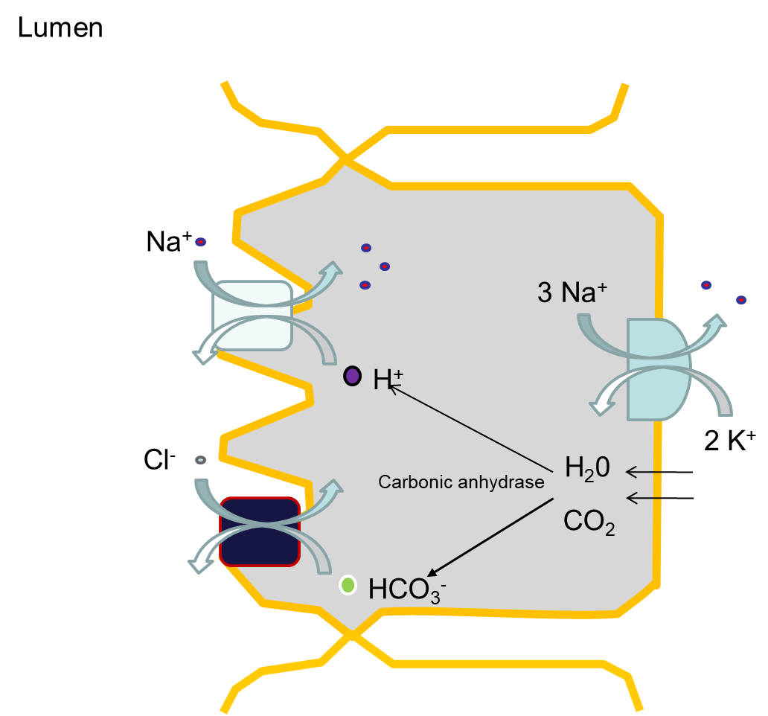
Route 3: electroneutral NaCl absorption
Electrochemical gradient
Cl⁻/HCO₃⁻ exchange absorbs Cl⁻
carbonic anhydrase helps supply H⁺ and HCO₃⁻
Electroneutral process (Na⁺ & H⁺ and Cl⁻ & HCO₃⁻)
important between meals, including ileum and proximal colon (fasted state)
Carbonic Anhydrase
Reversible reaction
H₂0 + CO₂ ↔ HCO₃⁻ + H⁺

Slide 22
Digestion and Renal Sciences
Part 3
Glucose absorption
From carbohydrate digestion to postprandial glucose entry

Slide 23
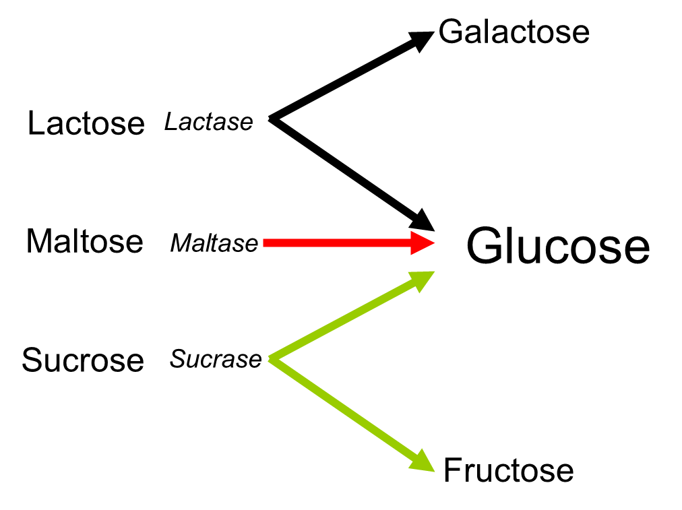
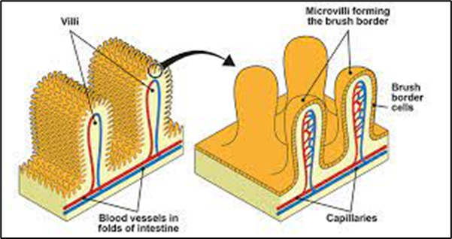
Carbohydrates must become monosaccharides
starch and glycogen digestion produces oligosaccharides and disaccharides
brush-border enzymes generate monosaccharides
glucose and galactose use Na⁺-dependent uptake
fructose uses facilitated diffusion
absorbed sugars enter portal blood and reach the liver first

Slide 24
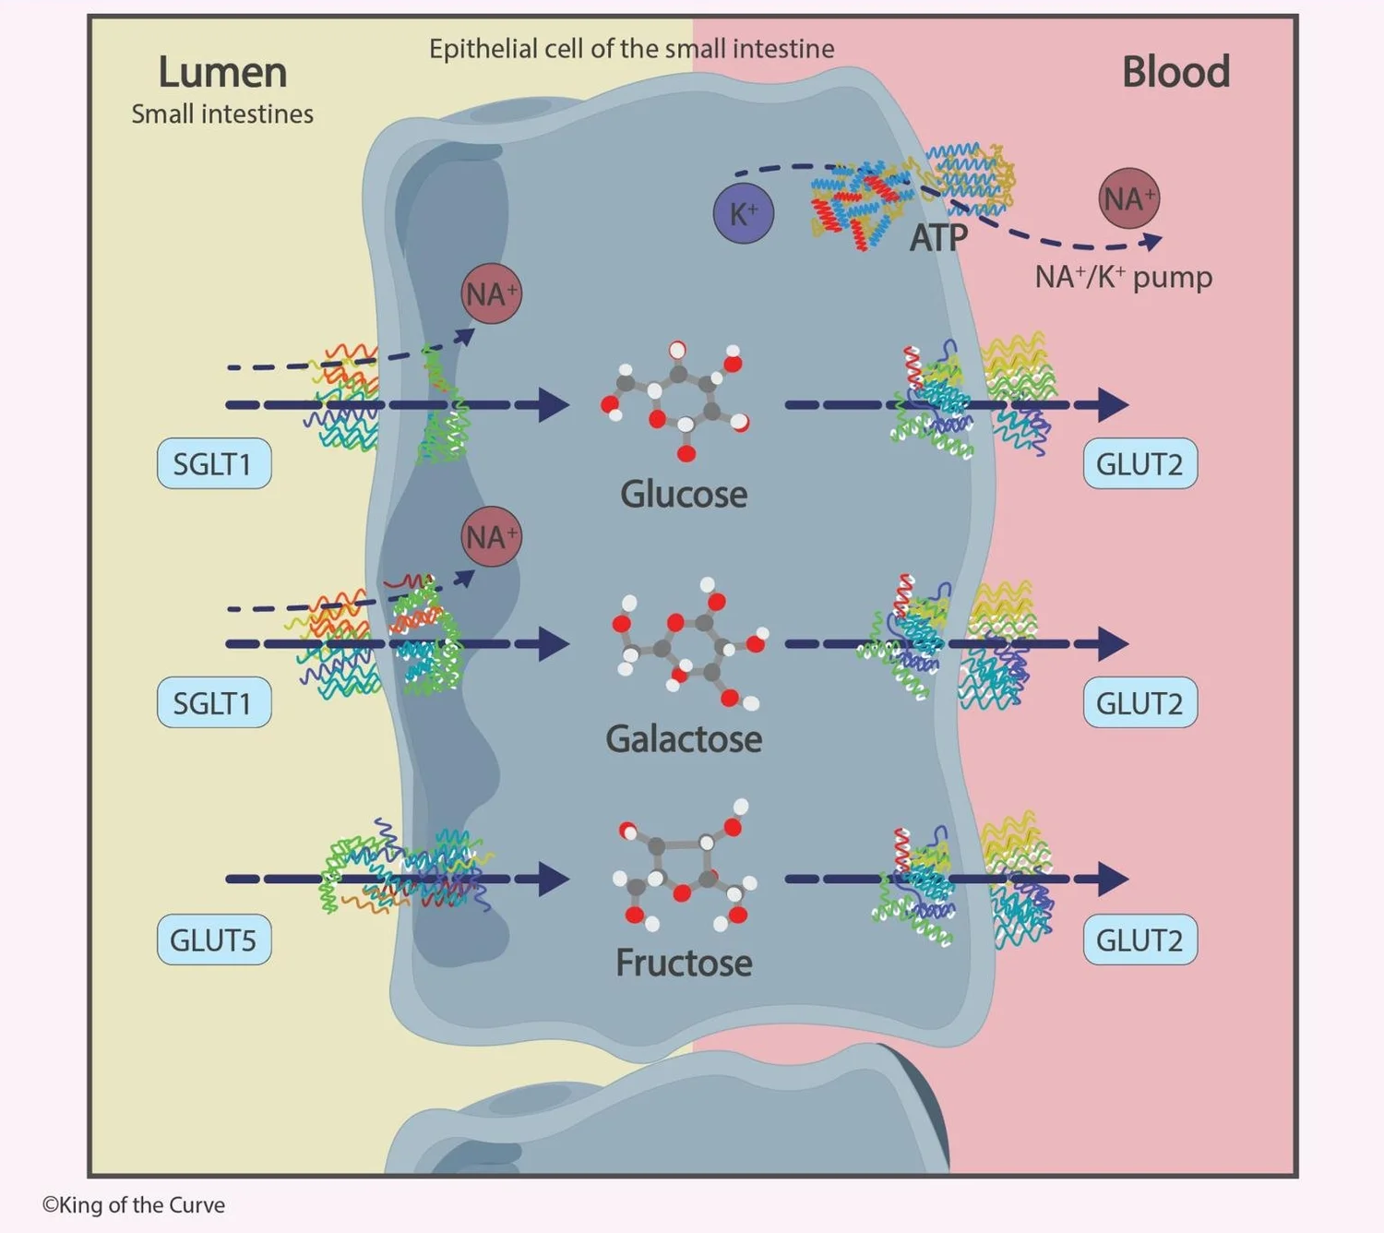
Glucose absorption: the core enterocyte model
Luminal glucose
Apical SGLT1 + Na⁺
Enterocyte cytosol
Basolateral GLUT2
Portal blood → liver

Slide 25
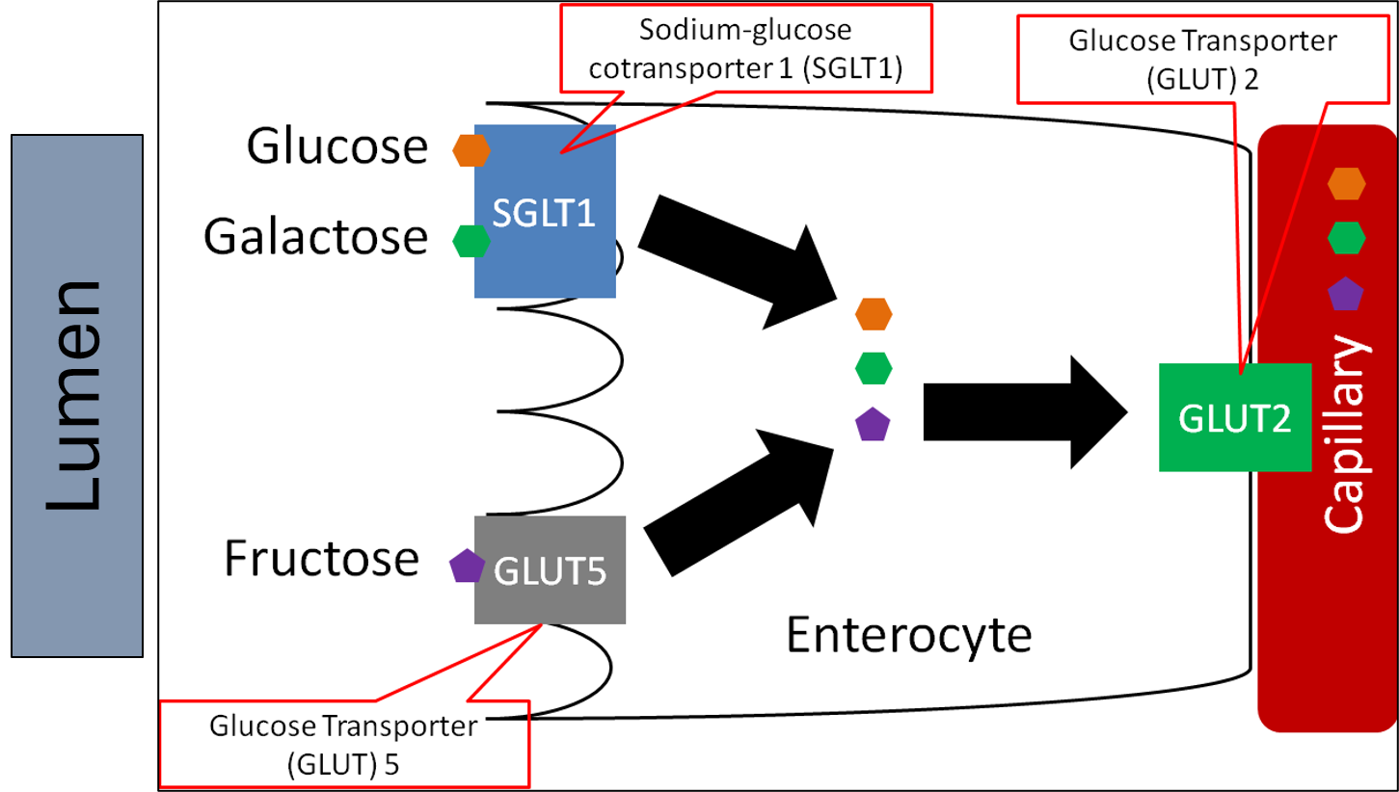
SGLT1: why glucose uptake is linked to Na⁺
located on the apical brush-border membrane of enterocytes
transports glucose and galactose with Na⁺
uses the Na⁺ electrochemical gradient, not direct ATP hydrolysis
supports rapid intestinal glucose absorption
contributes to glucose-dependent incretin signalling

Slide 26
Fructose is different: GLUT5, not SGLT1
fructose is absorbed mainly by facilitated diffusion
the apical transporter is GLUT5
transport is Na⁺-independent
fructose exits basolaterally through GLUT2 and related pathways
high fructose load can exceed absorptive capacity in some contexts

Slide 27
GLUT2: the main basolateral exit route
GLUT2 is classically located on the basolateral membrane of enterocytes
moves glucose down its concentration gradient into portal blood
also transports galactose and fructose
works after apical uptake has concentrated sugars inside the cell
connects intestinal absorption to hepatic metabolism

Slide 28
Digestion and Renal Sciences
Part 4
Enterotoxins and secretory diarrhoea
When epithelial signalling reverses the balance

Slide 29
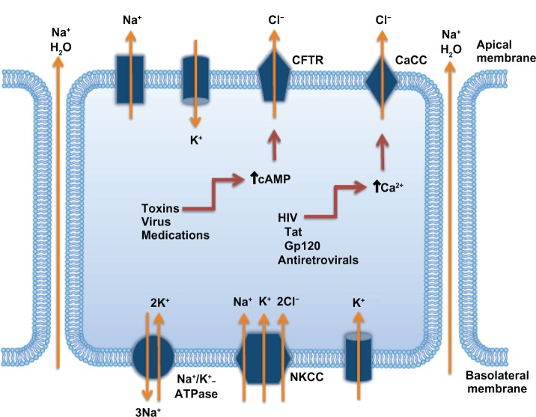
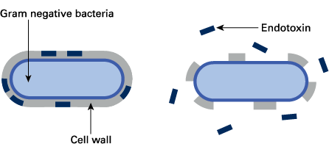
Secretory diarrhoea is transport physiology gone wrong
enterotoxin binds to intestinal epithelial cells
intracellular signalling changes, often cAMP, cGMP or Ca²⁺
Cl⁻ secretion increases, often through CFTR
NaCl absorption is inhibited
water follows electrolytes into the lumen

Slide 30
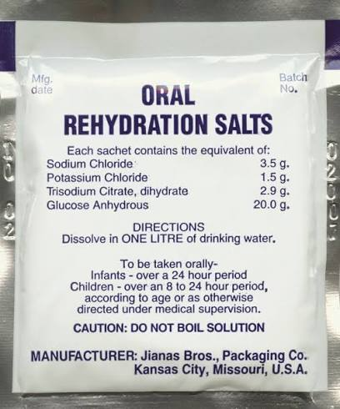
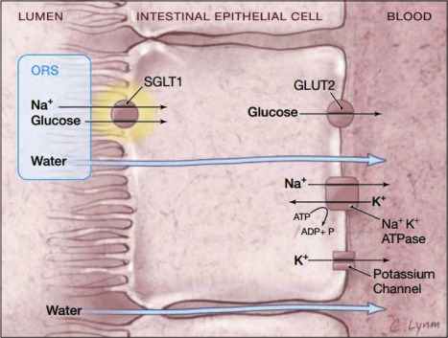
enterotoxins inhibit some NaCl absorptive pathways
Na⁺–glucose cotransport is relatively preserved
glucose + Na⁺ absorption creates osmotic water uptake
rehydration replaces both water and electrolytes
transporter-based therapy
Why oral rehydration still works in secretory diarrhoea
SGLT1 can remain functional when other NaCl pathways are inhibited.
Digestion and Renal Sciences | Absorption of ions, water and glucose
37

Slide 31
Digestion and Renal Sciences
Part 5
Calcium absorption
Passive route, active route and vitamin D regulation

Slide 32
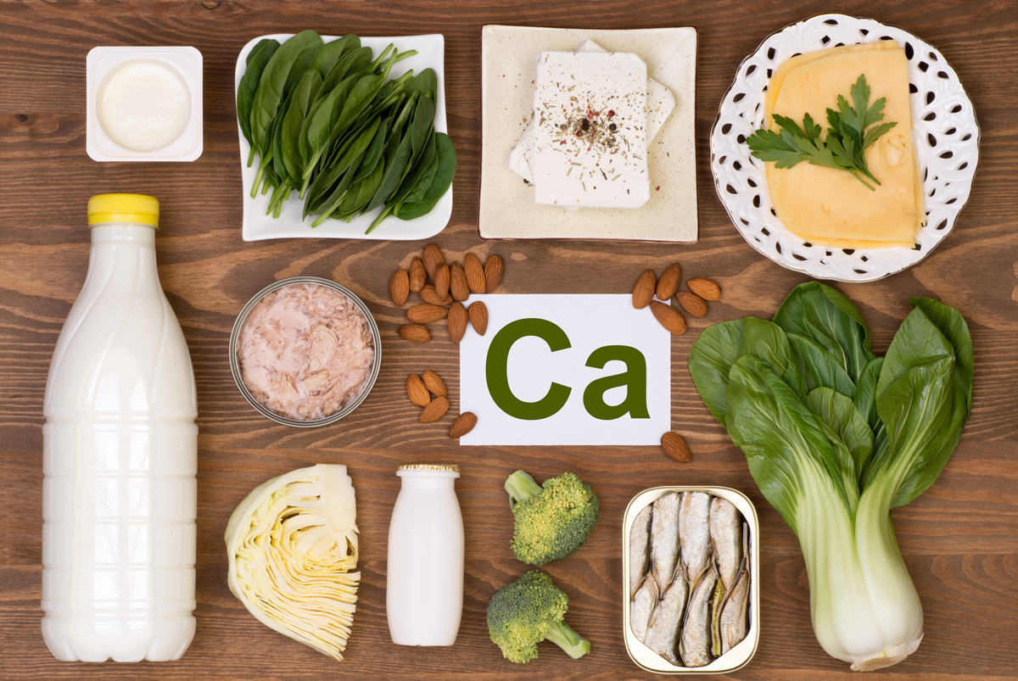
Calcium: what the intestine needs to achieve
dietary calcium enters the intestinal lumen
passive paracellular absorption rises with luminal load
active transcellular absorption is important when intake is low
vitamin D increases active transport capacity
net absorption changes with physiological need

Slide 33
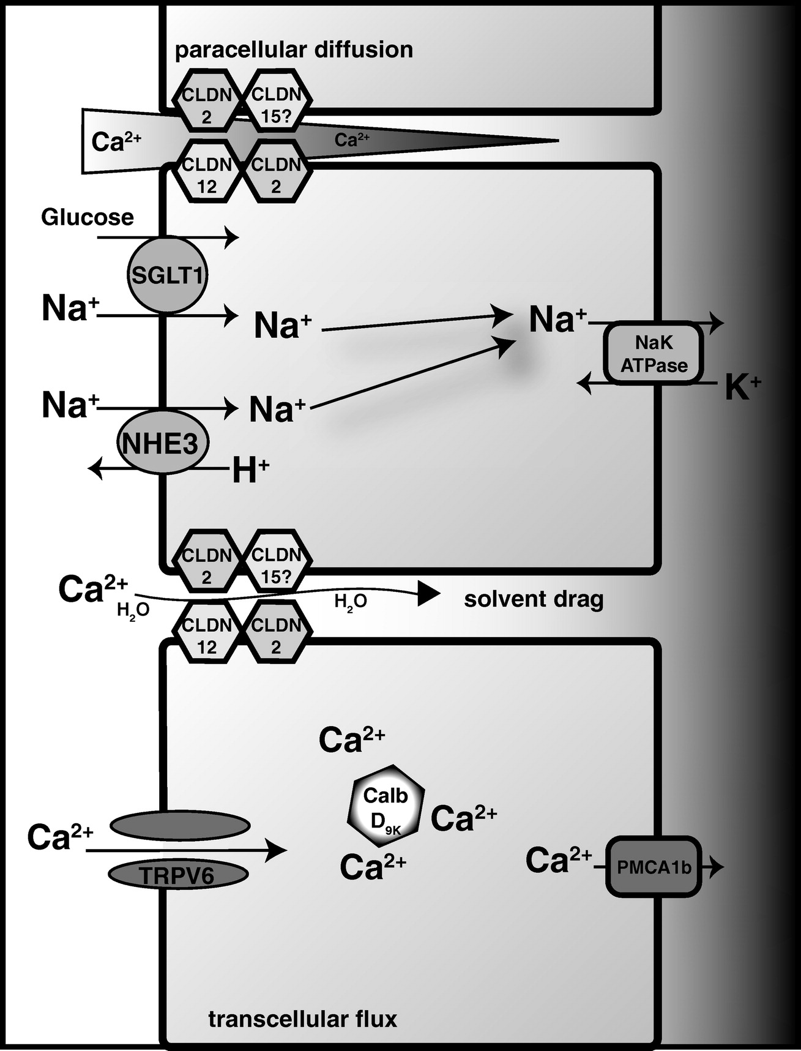
Two routes for calcium absorption
Active transcellular route
apical entry through TRPV6
Ca²⁺ binds calbindin-D9k in the cell
basolateral exit through PMCA
more important in duodenum
upregulated by vitamin D / VDR
Passive paracellular route
between enterocytes through tight junctions
driven by electrochemical gradient
more important when luminal Ca²⁺ is high
not strongly saturable in the same way
occurs along much of small intestine

Slide 34
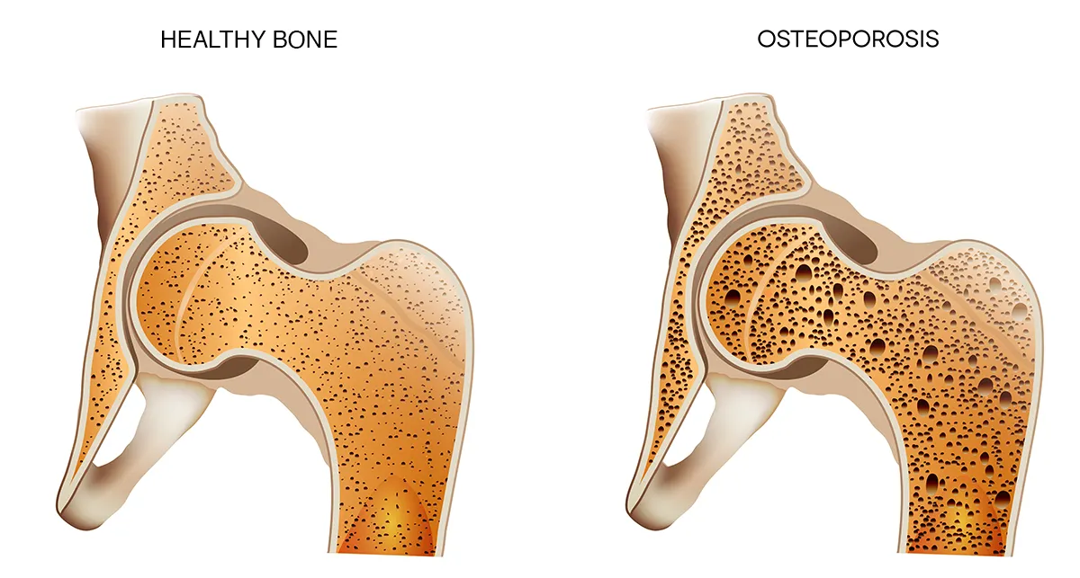
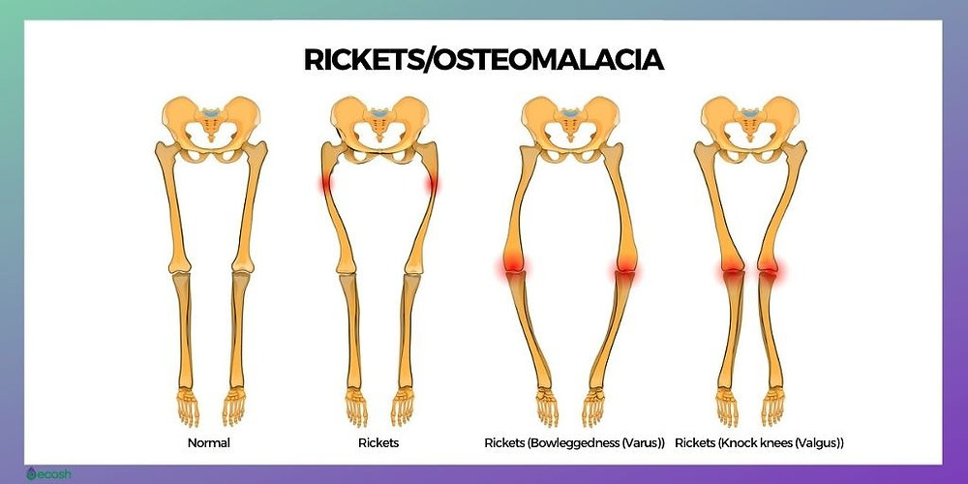
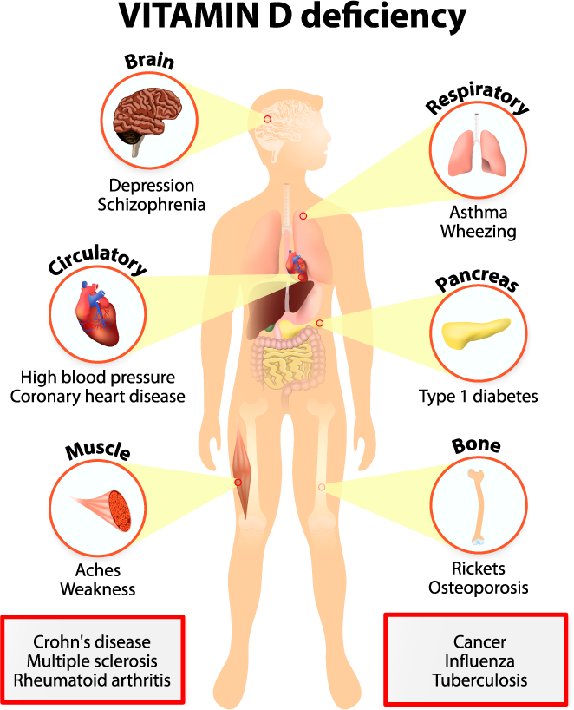
Calcium deficiency
Rickets / osteomalacia
Osteoporosis
defective mineralisation
rickets in children
osteomalacia in adults
often linked to vitamin D deficiency
bone may be soft and painful
reduced bone mass and architecture
fragile bone
mineralisation of remaining bone often normal
risk increases with age and hormonal factors
not the same as osteomalacia
  Vitamin D Deficiency
Poor diet / lack of sun
Bone softening
Demineralisation
Hypocalcaemia
Bone softening
Not the same as osteoporosis
45

Slide 35
Digestion and Renal Sciences
Part 6
Iron absorption and systemic regulation
A small absorbed amount with large consequences

Slide 36
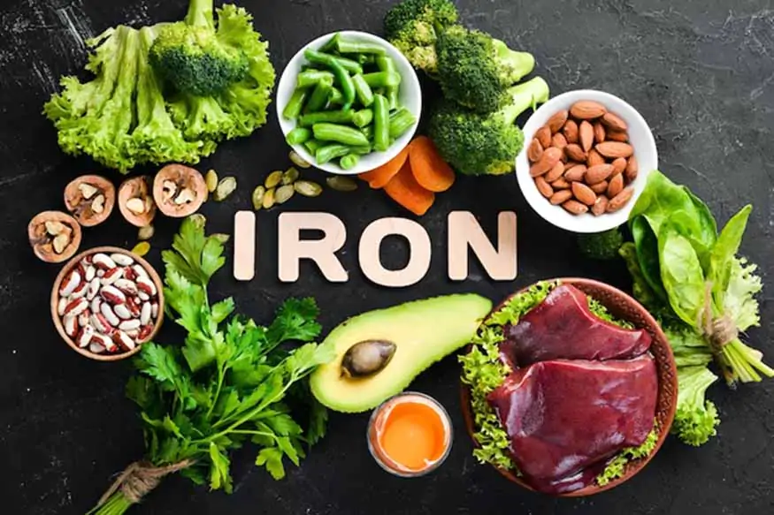
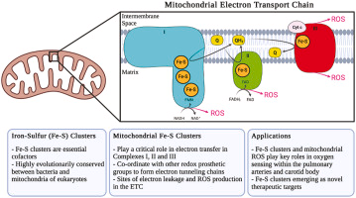
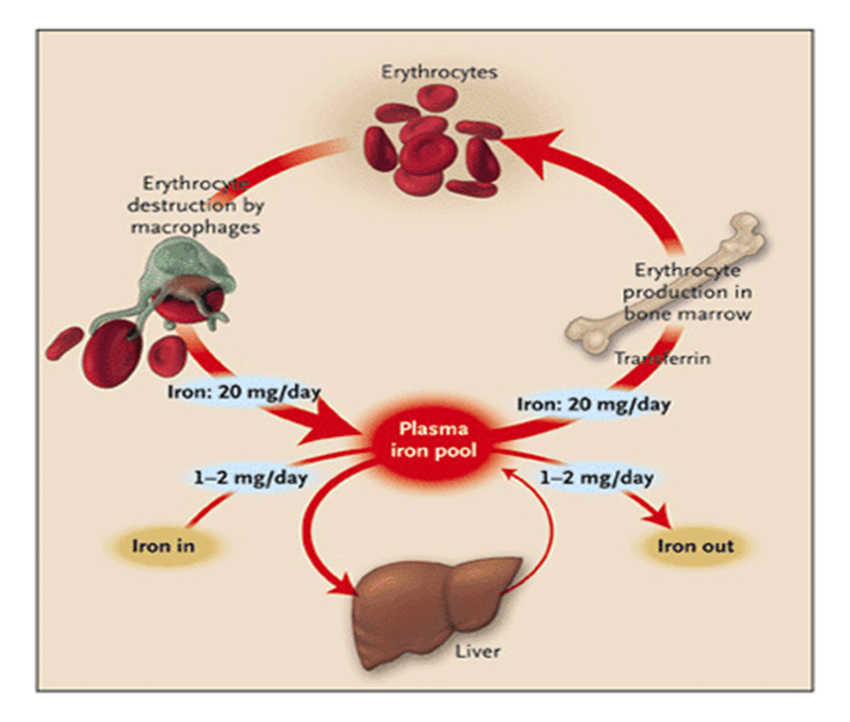
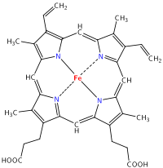
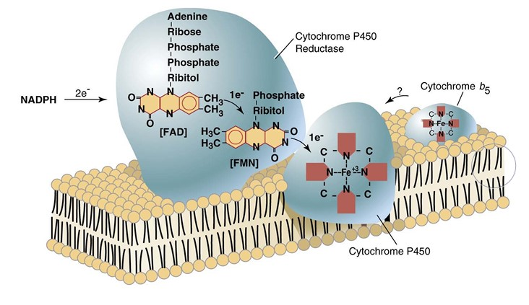
Why iron matters
oxygen transport:
haemoglobin and myoglobin
erythropoiesis in bone marrow
Energy production:
mitochondrial electron transport chain
iron–sulphur clusters and enzyme function
Enzyme:
Cytochrome P450 (CYP450)
DNA Helicase
Problem:
too little causes anaemia;
too much causes tissue damage

Slide 37
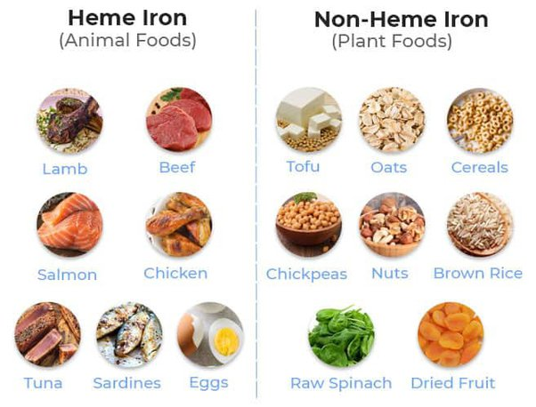
Dietary iron: haem and non-haem forms
Haem iron
Non-haem iron
animal sources
from haemoglobin and myoglobin
generally more bioavailable
absorbed by mechanisms distinct from DMT1-only model
contributes efficiently to body iron
inorganic iron, common in plant foods
often present as Fe³⁺
Fe³⁺ needs reduction to Fe²⁺
DMT1 transports Fe²⁺
inhibited or enhanced by dietary context

Slide 38
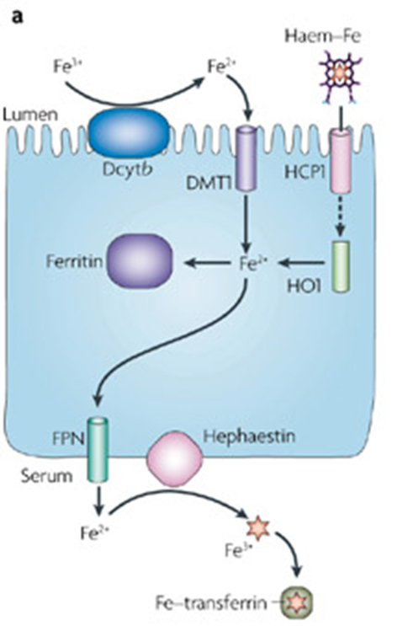
Fe in the body
Ferrous (Fe²⁺)
Ferritin (Fe³⁺)
Non-haem iron uptake at the enterocyte
Absorption of iron takes place in the small intestine
In food, Fe exists as ferritin, but it cannot be absorbed in this form
Fe³⁺ → Fe²⁺ (enzyme: ferric reductase; transporter: DMT1)
In cells, Fe²⁺ → Fe³⁺ (enzyme: hephaestin; transporter: ferroportin)
Fe³⁺ is then transported into the blood via a protein carrier -transferrin

Slide 39
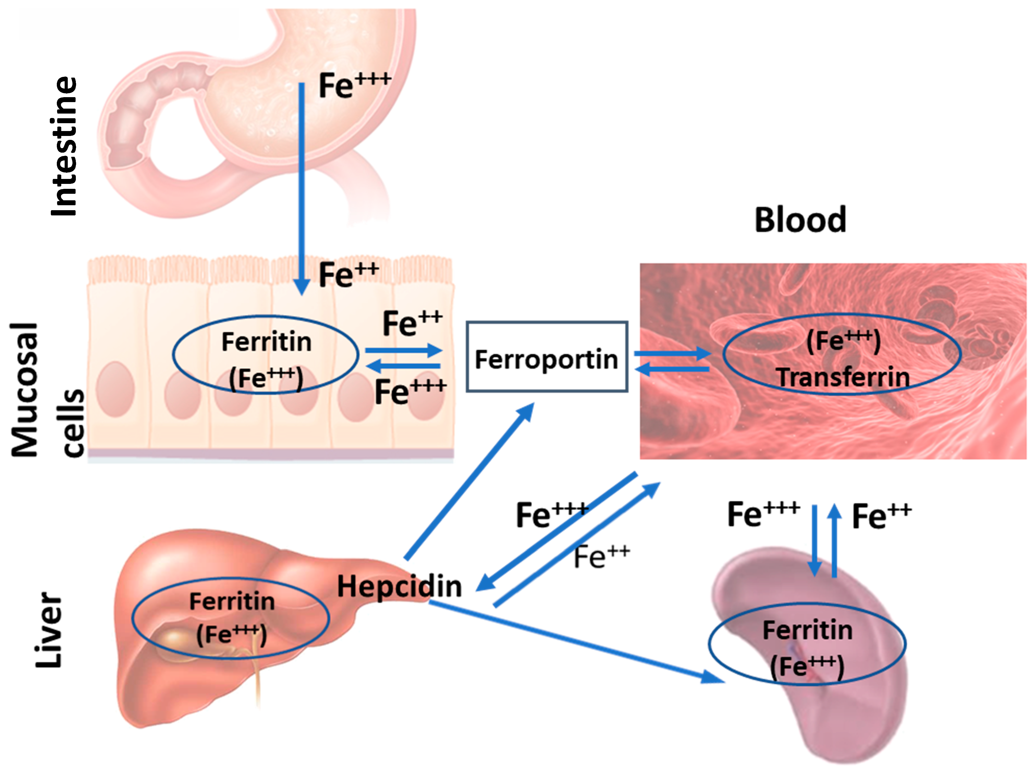
Fe + transferrin
Erythropoiesis (75%)
Synthesis of erythrocytes
Liver
Storage as ferritin
Once in blood: transferrin delivers iron
transferrin-bound iron circulates in plasma
bone marrow uses iron for erythropoiesis
liver stores iron as ferritin
macrophages recycle iron from old red blood cells
spleen recycling contributes to plasma iron availability

Slide 40
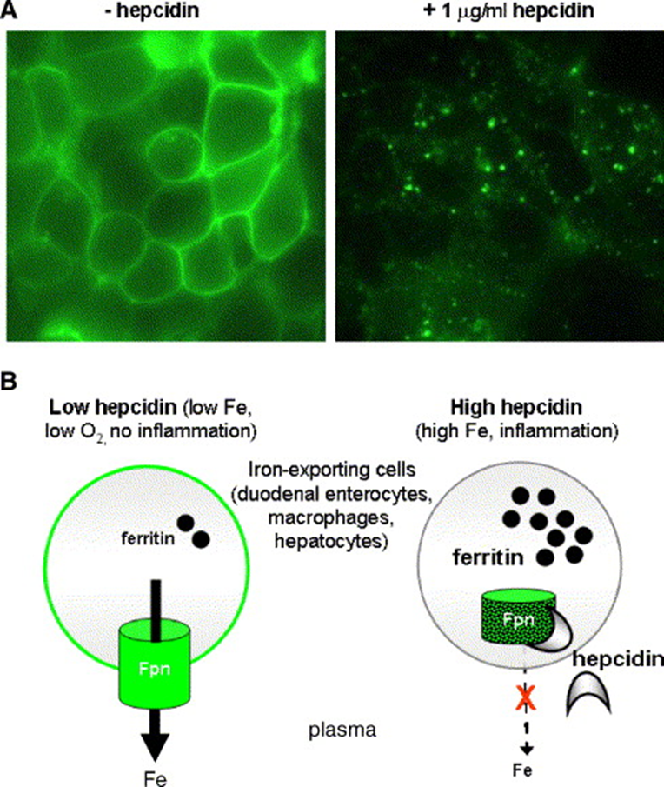
Hepcidin: the master regulator of plasma iron
Hepcidin inhibits ferroportin in the liver → ↓ plasma Fe concentration
Hepcidin inhibits ferroportin in the spleen too
The spleen recycles damaged/dead RBC → release Fe.
Ferroportin transports these Fe to circulation.
Hepcidin action = ↓ plasma Fe concentration
Hepcidin reduce absorption of Fe from the lumen of the small intestine.
  GFP labelled Fpn
  Fpn is in the plasma membrane of iron exporting cells
  ↓Fe levels > ↓Hepcidin > ↓inflammation

Slide 41
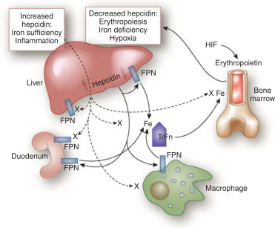
When hepcidin rises or falls
High hepcidin
stimulated by high iron and inflammation
IL-6 is an important inflammatory signal
ferroportin removed from membranes
iron trapped in enterocytes/macrophages
low plasma iron availability
Low hepcidin
occurs with low iron stores or high erythropoietic demand
ferroportin stays on membranes
intestinal export increases
macrophage recycling to plasma increases
plasma iron availability rises

Slide 42
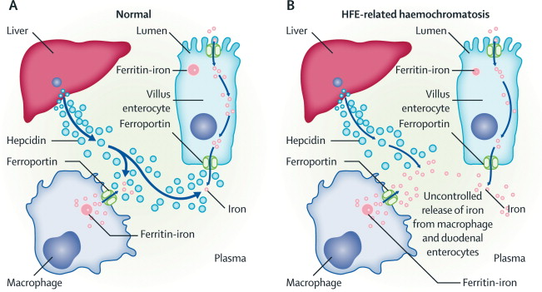
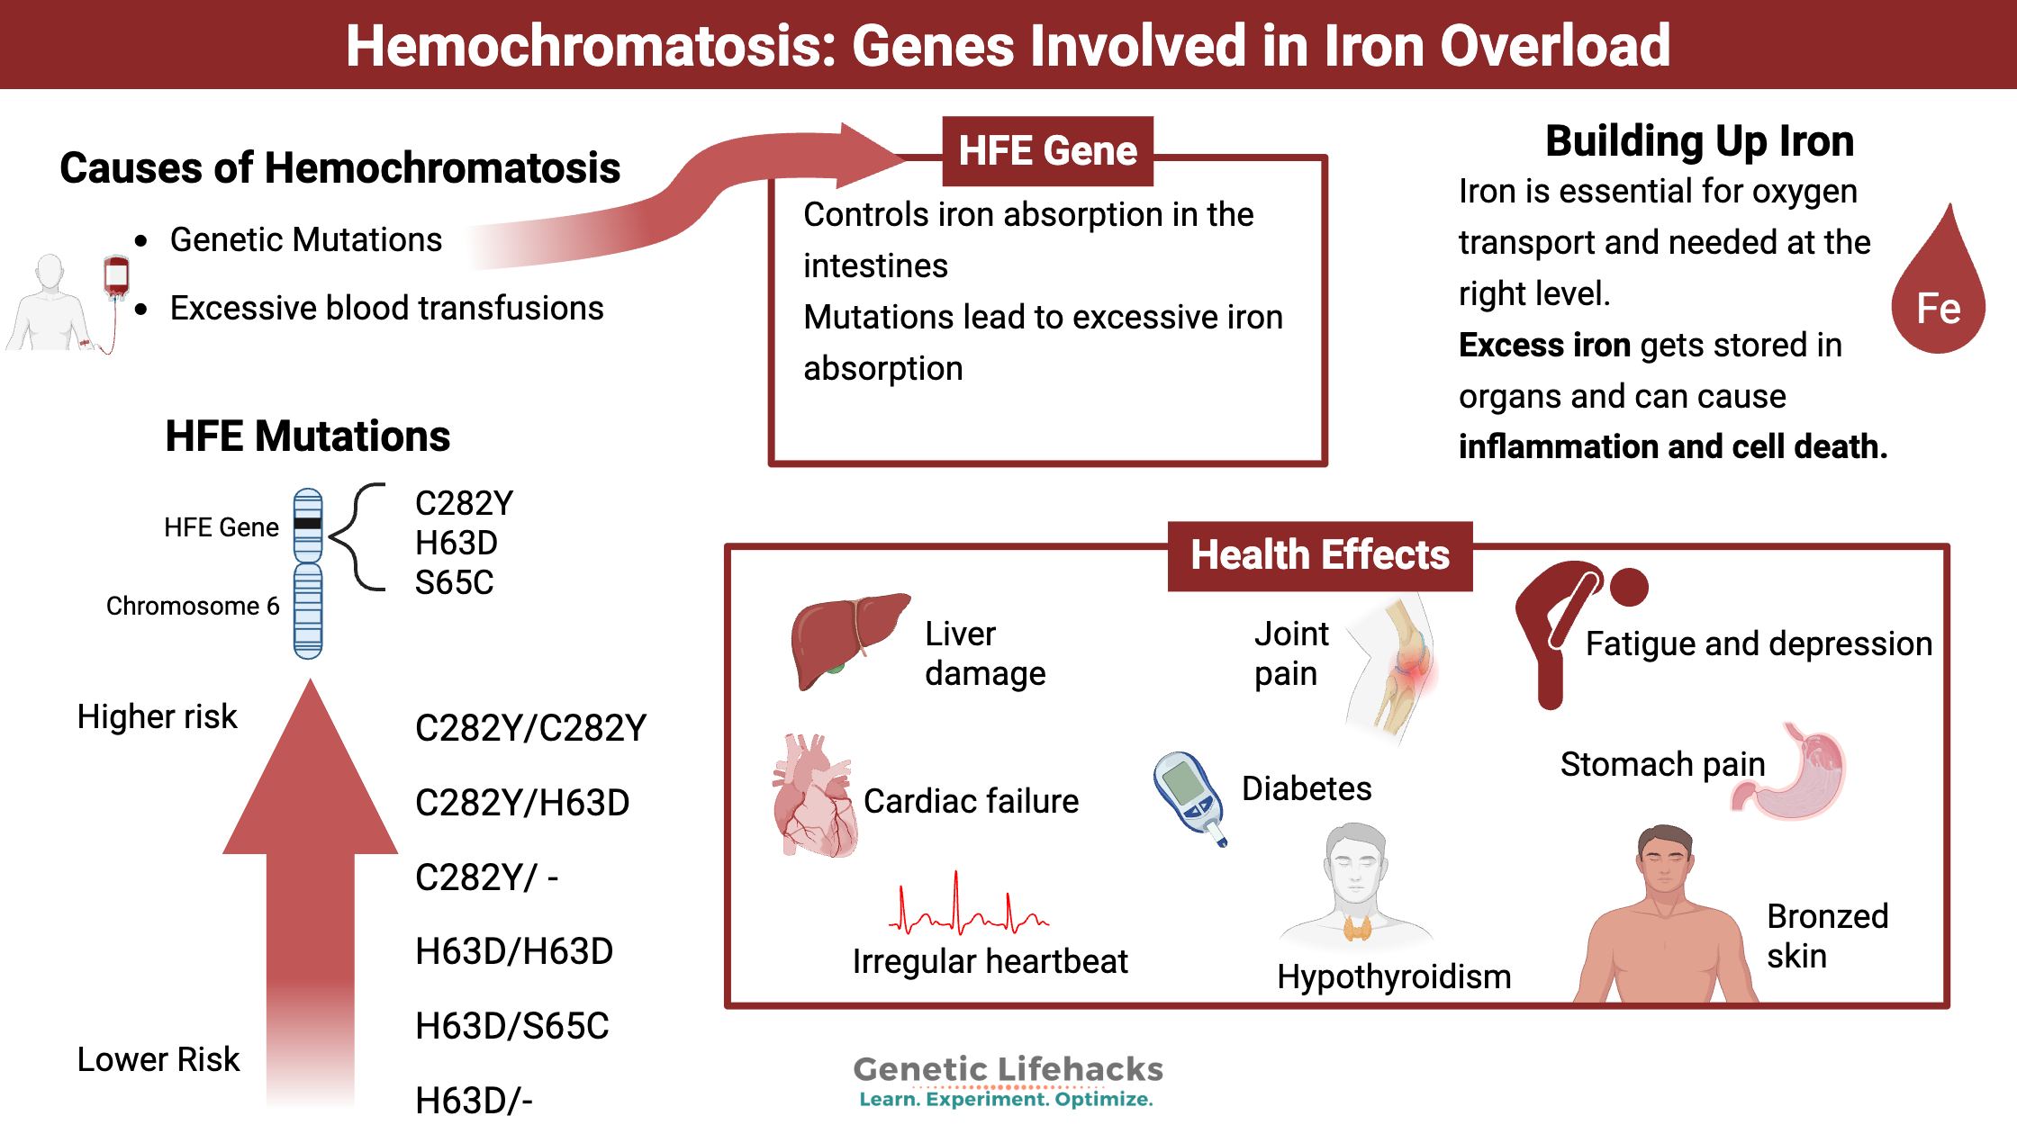
HFE mutation and hereditary haemochromatosis
HFE pathway helps regulate hepcidin response to body iron
HFE mutation can produce inappropriately low hepcidin
ferroportin remains too active for the iron load
iron accumulates in tissues
organ damage can include liver disease; treatment can include phlebotomy
  Overexpression of Hepcidin > Chronic anaemia (ACD) > Death

Slide 43
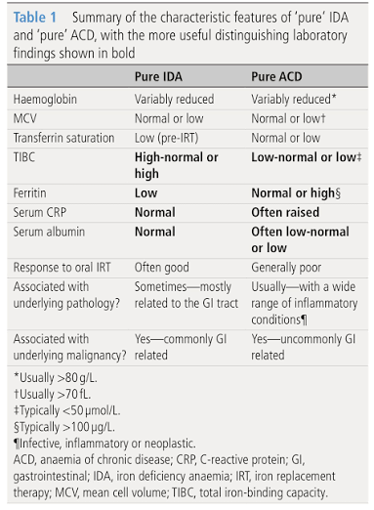
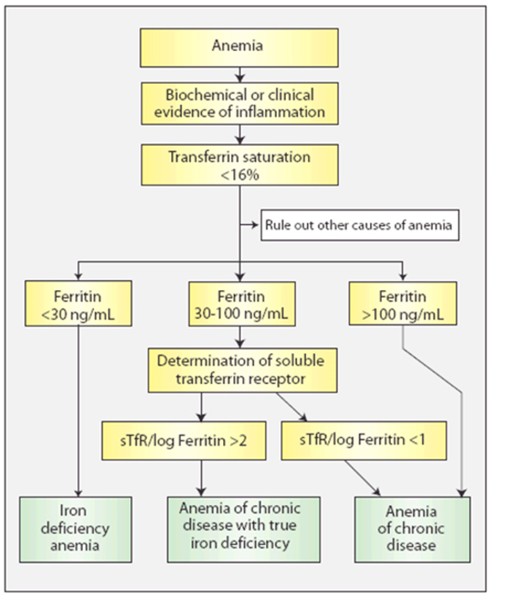
Iron deficiency anaemia (IDA) versus anaemia of chronic disease (ACD)
Digestion and Renal Sciences | Absorption of ions, water and glucose

Slide 44
Digestion and Renal Sciences
Part 7
Absorptive and post-absorptive states
From intestinal absorption to whole-body fuel handling

Slide 45
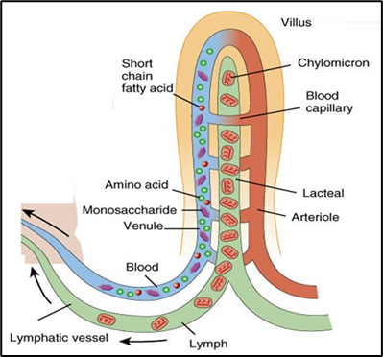
Absorptive versus post-absorptive state
Absorptive state / fed state
after a meal, nutrients are being absorbed
plasma glucose and amino acids rise
insulin secretion increases
immediate energy needs are met
excess fuel is stored as glycogen and fat
Post-absorptive state / fasting between meals
nutrient absorption from the meal has ended
insulin falls toward basal level
glucagon and counter-regulatory signals become more important
plasma glucose must be maintained
stored fuel is mobilised or spared

Slide 46
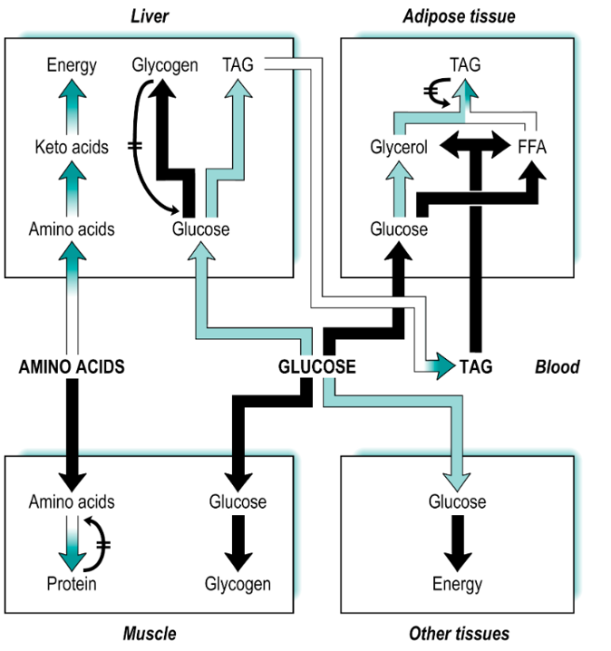
Absorptive state: where absorbed nutrients go
Intestinal absorption
Portal vein to liver
Liver stores / processes
Muscle uses and stores glucose
Adipose stores triglyceride
Plasma fuels fall back toward normal

Slide 47
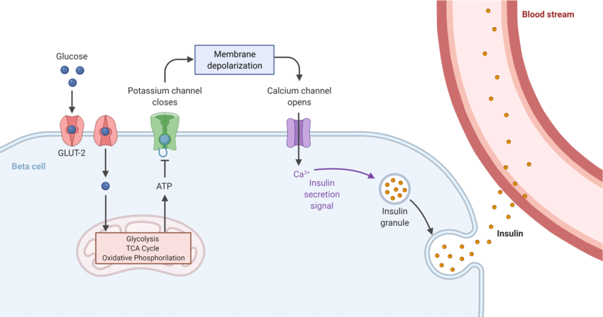
How high blood glucose stimulates insulin secretion
Absorptive state
  Feeding
  Uptake of glucose
  ↑Blood sugar
  Glucose > Enters pancreas > GLUT2 (animal model)> ↑ATP
β-cells (Islets of Langerhans)
  ↑ATP causes K+ channels to close
  Membrane depolarisation
  ↑ Ca2+ intracellular > Insulin exocytosis

Slide 48
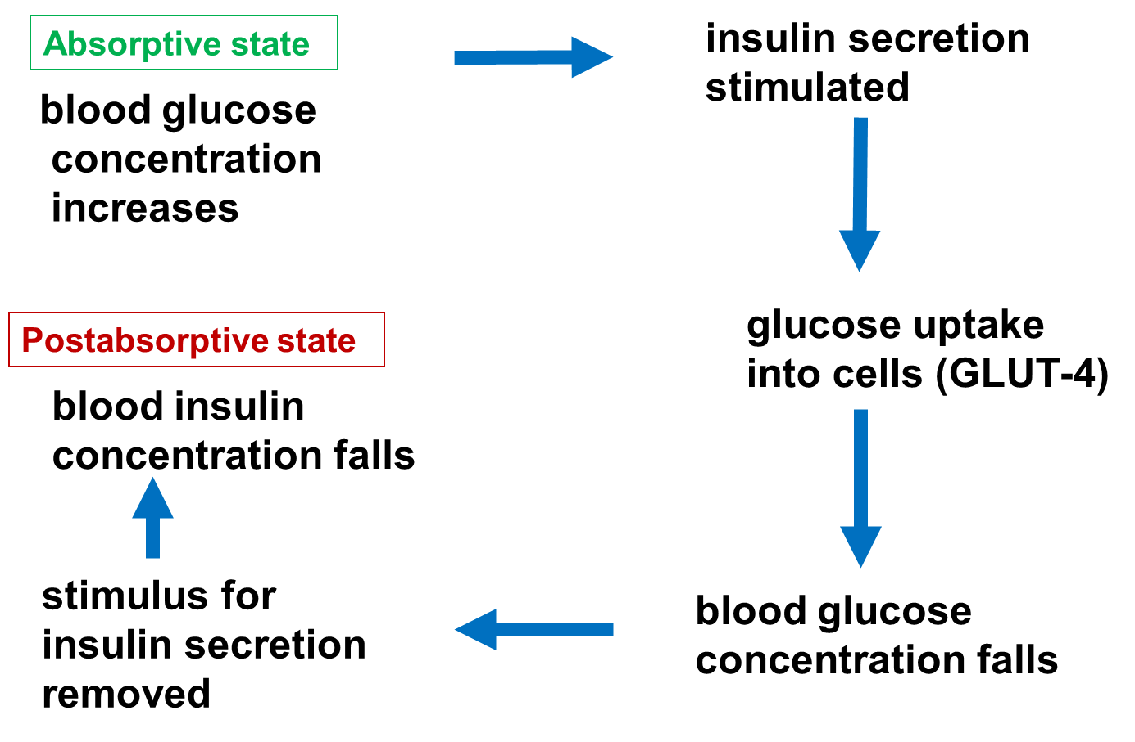
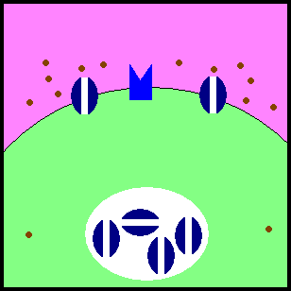
Insulin actions in the absorptive state
Hormone secreted by pancreas
Release stimulated by fed state/Inhibited by fasted state
High concentration of glucose/amino acids in the blood stimulates the release of insulin (fed state).
Systematic impact:
in muscle and adipose tissue: promotes GLUT4-mediated glucose uptake
in liver and muscle: promotes glycogen synthesis
in adipose tissue: promotes fat storage and reduces lipolysis
in liver: suppresses glucose production
overall effect: plasma glucose falls back toward normal

Slide 49
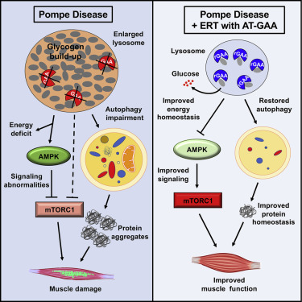
Storage reactions after a meal and Pompe Disease
glycogen is normally stored in cytoplasm of liver and muscle cells
Pompe disease involves lysosomal acid α-glucosidase deficiency
glycogen accumulates in lysosomes instead of being cleared properly
muscle and organ dysfunction can result
clinical point: storage is useful only if it can be mobilised safely

Slide 50
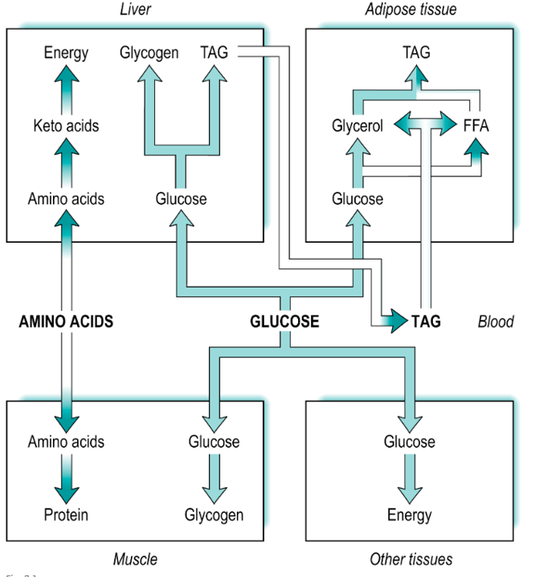
Post-absorptive state: maintaining plasma glucose
brain and red blood cells depend heavily on glucose availability
Lack of glucose = brain damage, coma, death
plasma glucose must be defended between meals
insulin falls toward basal level
glucagon becomes more important
liver releases glucose through glycogenolysis and gluconeogenesis

Slide 51

Glucose-supplying and glucose-sparing reactions
Glucose-supplying reactions
liver glycogenolysis releases glucose
gluconeogenesis makes glucose from lactate, glycerol and amino acids
muscle glycogen contributes indirectly via lactate
glucagon supports hepatic glucose output
aim: maintain plasma glucose
Glucose-sparing reactions
adipose lipolysis releases fatty acids
many tissues shift toward fatty acid use
liver produces ketone bodies during prolonged fasting
glucose reserved for brain/RBC needs
aim: reduce glucose demand

Slide 52

Diabetes as inappropriate post-absorptive physiology
plasma glucose is high, but insulin signalling is insufficient
muscle and adipose glucose uptake is impaired
liver glucose production may remain inappropriately high
lipolysis and ketone production can increase, especially in type 1 diabetes
the metabolic pattern resembles fasting despite nutrient abundance

Slide 53

Type 1 and type 2 diabetes: same hyperglycaemia, different first problem
Type 1 diabetes
loss of pancreatic β-cells
little or no insulin production
young onset is common but not exclusive
weight loss and ketoacidosis risk
requires insulin replacement
Type 2 diabetes
insulin resistance is central
insulin may be high early
β-cell function can decline over time
associated with age, adiposity and metabolic risk
managed through lifestyle and medications

Slide 54

Effect of diabetes on tissues
liver: increased glycogenolysis and gluconeogenesis can worsen hyperglycaemia
muscle: reduced glucose uptake contributes to wasting and weakness
adipose tissue: increased lipolysis raises circulating fatty acids
liver may accumulate fat in insulin-resistant states
ketone production can become excessive when insulin is very low

Slide 55

Testing diabetes uses fed and fasted logic
fasting blood glucose reflects post-absorptive glucose regulation
oral glucose tolerance reflects absorptive-state handling of glucose load
HbA1c reflects longer-term exposure of haemoglobin to glucose
poor glucose handling suggests insulin deficiency or insulin resistance
interpretation belongs in clinical context rather than one isolated number

Slide 56


Diabetes Treatment

Slide 57


GLP-1 agonists
Glucagon-like peptide-1 (GLP-1) agonists are in current use for the management of type 2 Diabetes Mellitus.
GLP-1 is a peptide produced by the intestinal enteroendocrine L cells
They work by activating GLP-1 receptors in the pancreas → ↑ insulin release → ↓ glucagon release → ↓ gastric emptying

Slide 58
Digestion and Renal Sciences
Part 8
Integration and exam reasoning
Turn transport mechanisms into clear answers

Slide 59
Exam-style prompt 1
Explain how glucose absorption can promote water absorption.
Pause, think, then answer
Expected answer
Na⁺/K⁺ ATPase maintains low intracellular Na⁺;
apical SGLT1 cotransports Na⁺ and glucose into enterocytes;
solute absorption creates an osmotic gradient so water follows from lumen to body.
Mention SGLT1 at the apical membrane.
Mention basolateral Na⁺/K⁺ ATPase.
Mention glucose and Na⁺ cotransport.
Finish with osmotic movement of water.

Slide 60
Exam-style prompt 1
Explain how glucose absorption can promote water absorption.
Pause, think, then answer
Mention SGLT1 at the apical membrane.
Mention basolateral Na⁺/K⁺ ATPase.
Mention glucose and Na⁺ cotransport.
Finish with osmotic movement of water.

Slide 61

Summary in six sentences
absorption is selective epithelial transport from lumen to body
Na⁺ gradients generated by Na⁺/K⁺ ATPase power multiple absorptive routes
water follows osmotic gradients created by absorbed solutes
glucose absorption uses SGLT1 entry and GLUT2 exit before insulin-directed tissue handling
Ca²⁺ and Fe show endocrine/systemic regulation through vitamin D and hepcidin
absorptive and post-absorptive states explain storage, fasting and diabetes physiology

